Slide 1
GenAI Based RCM Front Office Operations: Patient Doctor Interactions
Domain: Healthcare
AI Medical Scribe/Ambient digital scribe
Team Name: SSInnovators
Presented By
Satya Padmanabhan Iyer

Slide 2
AI Medical Scribe/Ambient digital scribe
Problem Statement
Healthcare providers spend excessive time on manual documentation, reducing patient engagement.
Inefficient coding and claim preparation lead to revenue leakage and delayed reimbursements.
Lack of automation in front-office operations results in administrative overhead and human errors.
Need for real-time, accurate, and compliant documentation from patient–doctor conversations.
Proposed Solution
Develop an AI-based medical scribe that transcribes and understands patient–doctor conversations.
Automate generation of structured medical documentation with coding and compliance review.
Integrate with RCM workflows to speed up claims and minimize denials.
Use multiple autonomous AI agents to perform specialized tasks collaboratively.
Expected Benefits
Real-time transcription and structured documentation improve provider efficiency.
Enhanced coding accuracy reduces claim denials and accelerates reimbursement.
Compliance validation ensures HIPAA adherence and quality assurance.
Scalable, modular agent-based design adaptable to different specialties.
Improved patient experience through reduced provider administrative load.

Slide 3
Agentic AI Workflow With Agent
AI Medical Scribe/Ambient digital scribe
1. voice_to_text_task
Input: PipelineState(source_audio)
Actions:
-Converts raw clinical audio (patient–provider conversation) into transcript text.
-Extracts timestamps and word-level confidence using an ASR (Automatic Speech Recognition) model.
-Populates raw transcript and save under transcript folder
Output: transcript, state.logs
2. clinical_understanding_task
Input: state.transcript
Actions:
-Calls CrewAI clinical_understanding_agent to interpret the transcript into structured context.
-Extracts symptoms, conditions, diagnoses, assessment, and plan (SOAP-style).
-Generates ClinicalUnderstandingData with reasoning and confidence scores.
Output: state.clinical_understanding, state.logs
3. rcm_coding_task
Input: state.clinical_understanding
Actions:
-Runs CrewAI rcm_coding_agent to assign medical codes.
-Maps findings to ICD-10 (diagnosis) and CPT (procedure) codes with appropriate modifiers.
-Adds coder justification and confidence metadata.
Output: state.rcm_coding, state.logs.
WORKFLOW
START
↓
voice_to_text_task
↓
clinical_understanding_task
↓
rcm_coding_task
↓
front_office_task
↓
compliance_quality_task
↓
document_task
↓
END

Slide 4
Contd .. Workflow
AI Medical Scribe/Ambient digital scribe
4. front_office_task
Input: state.rcm_coding
Actions:
-Checks patient eligibility, payer name, and plan details from front-office context.
-Verifies if prior authorization is required or already present.
-Generates workflow task list and turnaround time estimation.
Output: state.front_office, state.logs.
5. compliance_quality_task
Input: state.front_office
Actions:
-Performs PHI redaction and HIPAA compliance validation.
-Runs quality checks on completeness, correctness, and confidentiality.
-Updates phi_redacted_text, hipaa_audit_passed, and adds findings.
Output: state.compliance_findings, state.logs.
6. document_task
Input: All accumulated state data (voice_to_text, clinical_understanding, rcm_coding, front_office, compliance_quality).
Actions:
-Synthesizes structured EHR-ready documentation.
-Generates formatted output (JSON/PDF) containing patient summary, codes, compliance report, and billing data.
-Finalizes state.structured_output and submission status.
Output: state.structured_output, state.ehr_submission_status, state.logs.

Slide 5
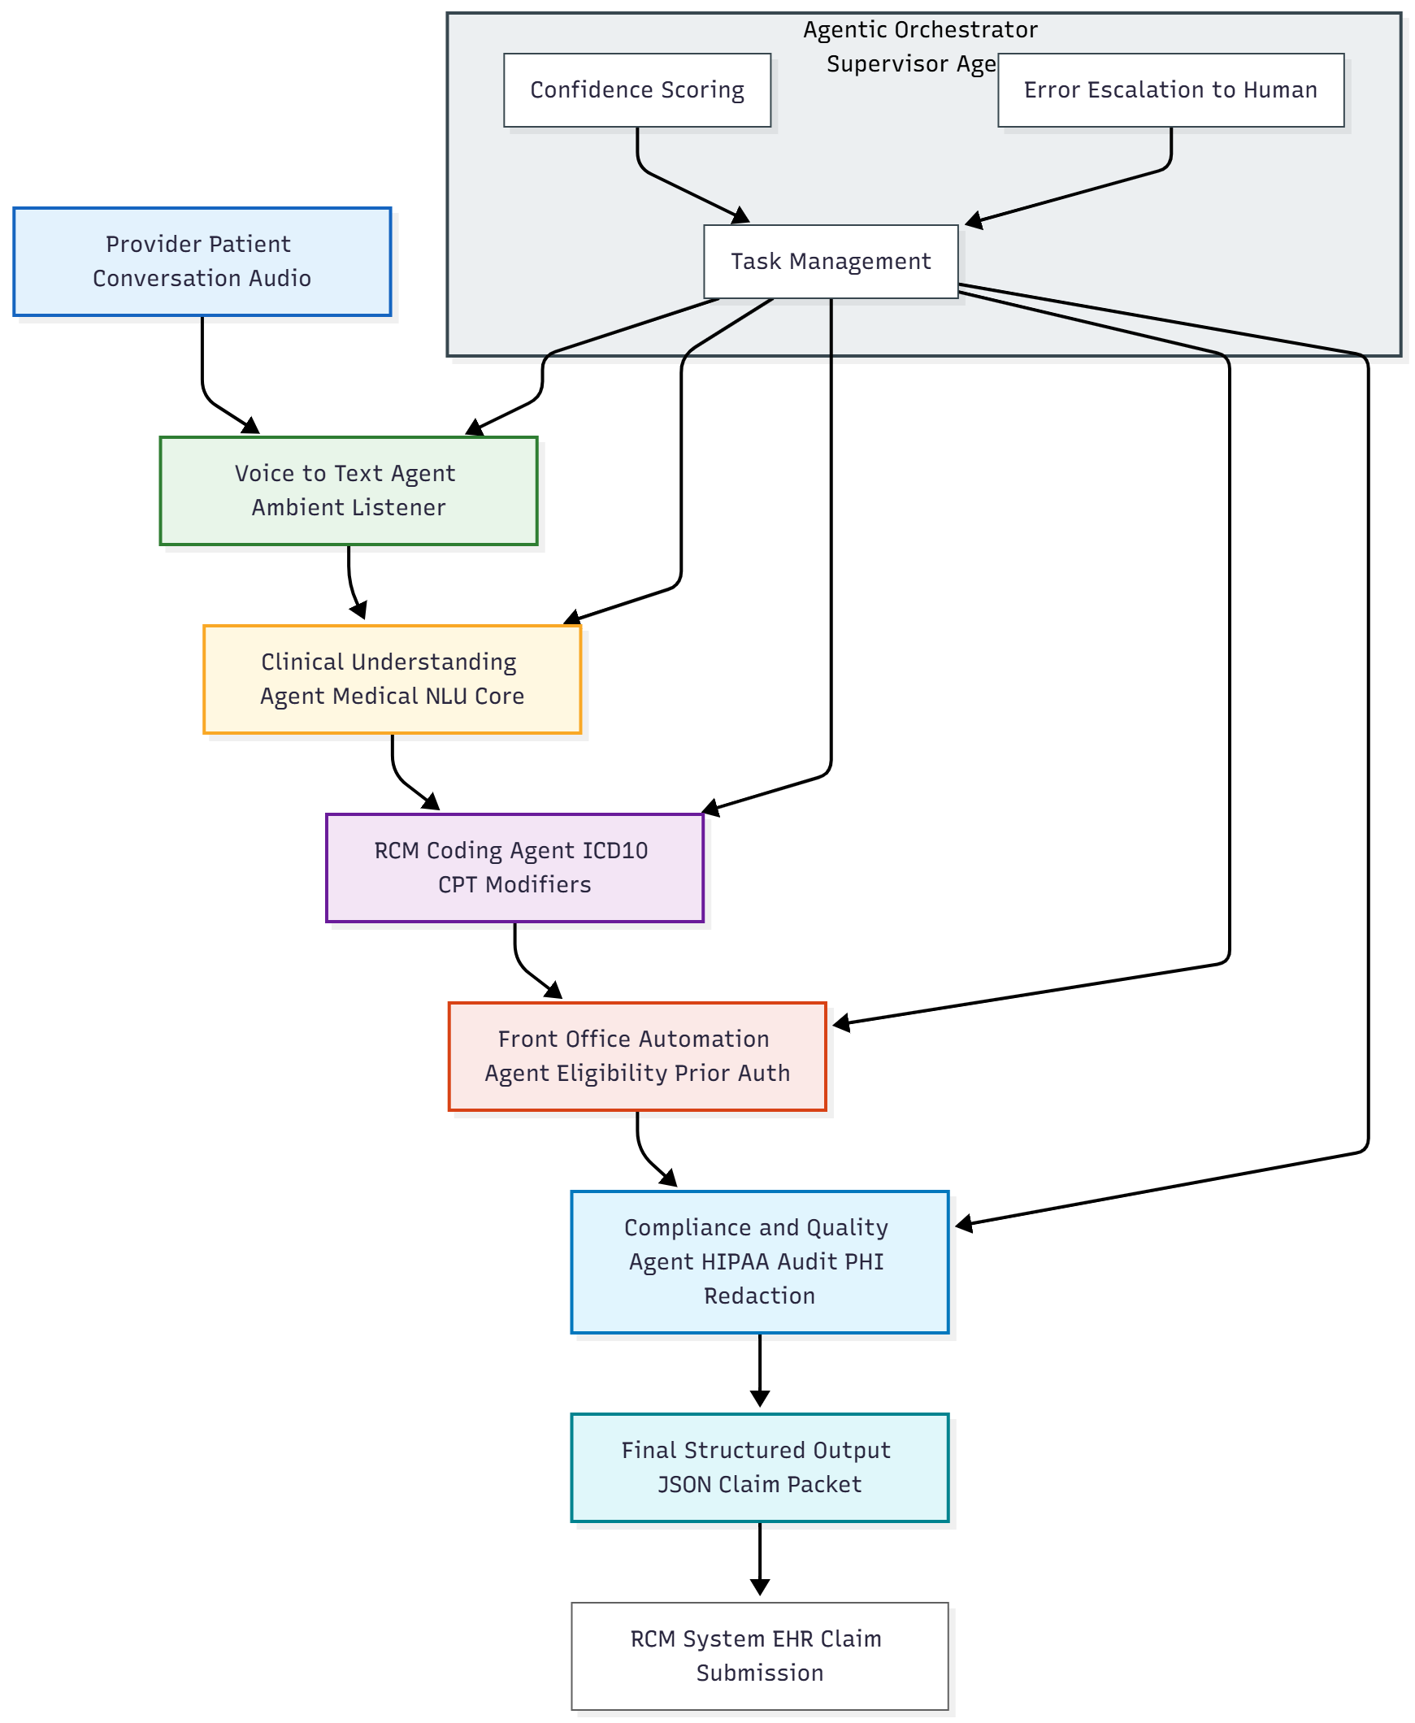
System Architecture Overview
AI Medical Scribe/Ambient digital scribe

Slide 6
Agents Workflow Overview
AI Medical Scribe/Ambient digital scribe

Slide 7
Technical Stack
AI Medical Scribe/Ambient digital scribe
Frameworks: CrewAI, LangGraph (agent orchestration & workflow management)
Backend: Direct mocked Audio files is used. But later we can integrate with FastAPI (REST APIs for transcription, note generation, and retrieval)
Database: Now no database is used , It is directly stored as PDF inside folder with timestamp. .But in future we can use Pinecone
Frontend / Visualization: Streamlit (interactive UI for audio upload, transcription, and note review)
AI Models: Claude, AWS Bedrock foundation models (speech-to-text, summarization, medical note generation)

Slide 8
Future Roadmap
AI Medical Scribe/Ambient digital scribe
Integrate with EHR/EMR systems for automated record updates.
Enhance LLM capabilities for multi-language and specialty-specific documentation.
Add predictive analytics for claim success and revenue optimization.
Enable secure cloud deployment with role-based access control.
Expand dataset sources for continuous model fine-tuning and compliance benchmarking.

Slide 9
Thank you
AI Medical Scribe/Ambient digital scribe

